Slide 1

Paramov: Smart IOT based Paralysis Patient Monitoring System
SRM INSTITUTE OF SCIENCE AND TECHNOLOGY
COLLEGE OF ENGINEERING AND TECHNOLOGY
18CSP1079 - MAJOR PROJECT
Vanshaj Barnwal(RA2011032010035)
Vinay Poddar(RA2011032010061)
Batch ID:
Guide name and Designation:
Ms. Saisanthiya D, Assistant Professor

Slide 2
Table of contents
Project Title And Abstract
Problem Statement
Solution
Objectives
Literature Review
Architecture Diagram
Flow Diagram
Modules
Conclusion
References

Slide 3
Abstract
People who are paralyzed cannot express their demands since they cannot talk effectively. A paralytic smart health system can let patients and caregivers communicate more easily.
To recognize gestures and perform intricate hand and finger motions, combine several sensor types such as pressure, gyroscopes, and accelerometers.
Continuous data streams monitor vital signs, activity, sleep, and environmental interactions, enabling early detection of complications, infections, and falls, and triggering preventative interventions.
To help caregivers make wise decisions, the smart gloves have to offer real-time feedback on finger movements.
User-friendly interface for easy monitoring and management of Smart Paralysis Healthcare System.

Slide 4
Problem Statement
Paralyzed people are unable to communicate their needs since they cannot speak clearly. A paralytic smart health system can facilitate communication between patient and caregivers.
Traditional rehabilitation methods often have limited effectiveness, are time-consuming, and require intensive therapist involvement.
Paralyzed patients find difficulty in communicating pain, discomfort, or needs to caregivers.
User interface should be friendly, otherwise it will be difficult to understand and use the smart paralytic health system.
Existing assistive devices for hand paralysis often lack precision, intuitive control, and adaptability to individual needs.

Slide 5
Solution
Key features of Smart Paralytic Healthcare System:
User-Friendly Interface: Easily monitor and manage Smart paralytic healthcare system.
Restore Functional Movement: Develop smart finger technologies that support or augment natural hand and finger movement, enabling daily tasks and activities.
Proactive Health Monitoring: Utilize sensors to monitor Vital signs, activity, sleep, and environmental interactions for early detection of complications or risks.
Instant communication: Smart devices enable patients to report discomfort or changes in well-being to caregivers for immediate response and support.
Data Security and Privacy: Robust encryption measures for safeguarding sensitive information.

Slide 6
Objectives
Multimodality: Combine different sensor types like pressure, gyroscope, and accelerometer for richer data collection, enabling gesture recognition and complex hand/finger movements.
Fall prevention: Monitor sudden movements or changes in position to identify potential fall risks and trigger alerts or alarms for assistance.
Real-time Feedback: The smart gloves should provide real-time feedback on finger gesture, allowing caregiver to make well-informed decisions.
Comfort & Safety: Ensure the glove is durable, lightweight, and hypoallergenic for comfortable long-term wear.
Data security: Implement robust data encryption and privacy protocols to ensure user data confidentiality and prevent unauthorized access.

Slide 7
Literature Review
[1] The proposed system enables people with severe paralysis to communicate their thoughts and needs. It also helps patient to show their intellectual potential which can sometimes dispose their mental disability diagnosed by the doctor. The proposed patient provides a unique and new UI which can be easily controlled by any age group patient. The proposed system combines existing techniques in a new way to detect eye motion and eye blink detection. The Eye Motion Algorithm is used to determine left, right or no motion. The Eye Blink Detection Algorithm is used to determine voluntary and Involuntary eye blinks can be used as a blink gestures in the proposed system. These two algorithm helps the patient to navigate efficiently in the proposed system and communicate. The proposed system, Consumer Grade PC/Laptop and Logitech webcam of $23.53 is used which decrease the cost and boost the use of the system in various environment like private or government hospital personal nursing, home, etc. The system setup and maintenance doesn't require any skilled labor and hence will reduce the cost of the system. The main drawback is system accuracy decrease in low lighting conditions and the webcam should always be in line of sight with eye of the patient.[1]

Slide 8
Literature Review
[2] IoT enabled Paralysis patient healthcare helps to know the health status and needs of the patients by being at a remote place. This system model plays a vital role by being an assistive aid for people who are affected by paralysis. The IoT cloud stores the messages gives an overview of the health status of the patient over a period of time. Further development can be made by using additionally gyro sensor and flex sensors which brings in more applications to be included to our proposed system. Gyro sensor can be used for the purpose of measuring the rotational movement of the hand and flex sensor can be used to detect the motion made by individual fingers. GSM module can be used additionally for the purpose of sending the messages conveyed by the paralyzed patients by sending a SMS to the registered person.[2]

Slide 9
Literature Review
[3] In this paper, it presents a complete diagnosis system for non-contact human abnormal gaits detection based on S-band wireless state information. The proposed system can help early detection of gait abnormalities, which is essential in clinical diagnosis. We mainly focused on four human gait patterns including normal, festination, small stride and turn. Hamper filter are utilized to detect outliers and wavelet transform are applied to filter the noise in wireless data. After obtaining the image of data, we then linearize the image, resize and chop it to a proper size. SVM was selected because its high precision and robustness in many traditional machine learning problems. It was applied to both binary classification and multi-class classification. Comparisons between using and not using image processing module illustrate that it can improve the performance of the system at least 5%. The multi-class accuracy rate of our method is 96.7% which demonstrate that our system is an efficient, low-cost and reliable solution for automatic detection and diagnosis paralysis agitans based on their abnormal gaits. The future task work on improve the speed on detection is warranted.[3]

Slide 10
Literature Review
[4] When a patient enters the stage of paralysis, it is quite impossible to determine when he or she may regain consciousness. The paralysis may continue from days, weeks, months, and years together. It becomes difficult for hospital professionals to continually watch and monitor the patient in these settings, and little body movements, realistic indicators, and aberrant activity might be overlooked.[32] To avoid this circumstance, the suggested system is outfitted with a variety of portable sensors that are affixed to the patient's body. Health monitoring has played a major role in the healthcare industry. It is a high-quality alternative for traditional health management. In this digital world, e-health plays an active role which includes improvised healthiness in low cost and high quality. Medical informatics in this century leads a major role, it comprises of technology used for sharing, retrieving medical information for a new path. Technologies that include the Internet of Things (IoT)[28] and Artificial Intelligence (AI) are used in telemedicine. The major advantages of telemedicine are the minimization of travel time and cost. By adopting these technologies the work contributes to monitoring the vital parameters effectively.[4]

Slide 11
Literature Review
[5] In these recent years, people are much more concerned about their health as diseases arising day by day are more. Hence it is very much important to monitor the health. This paper presents the design and implementation of IOT based health monitoring system which incorporates temperature and pulse rate sensors. The patient’s body will be monitored continuously and the doctor can know about the patient’s condition while sitting somewhere in front of a computer screen. Whenever the condition of the patient goes abnormal an alert will be sent to the doctor through the mail so that he can diagnose the problem immediately which helps to save patient’s life. The main purpose of this project is to inform the doctor about the patient’s health condition time to time and if any abnormality occurs, the doctor can take the best step immediately. [5]

Slide 12
Literature Review
[6] The proposed system highlights the shortcomings in our traditional healthcare system with the increasing aging population and overcome it by giving affordable, secured, fast and portable system by utilization technically sound devices(Arduino, raspberry pi ,sensors) and systems(IoT, Network topologies). Although this system is good tool for remote patientcare, but still future improvement can be made to make it more efficient. Adding a video conversation between patient and doctor can make the system more patient’s friendly. GSM/GPRS module can be used to create message alert whenever patient sensor data is approaching to abnormality. Addition of more health-related sensor will make one’s life more independent and convenient. [6]

Slide 13
Literature Review
[7] As health care administrations are essential piece of our society, computerizing these services reduces the weight on people and facilitates the measuring procedure. Additionally the easy of access of this system helps patients to rely on it. The goal of creating such a system is to decrease health mind costs by diminishing doctor office visits, hospitalizations, and demonstrative testing method. Many further upgrades can be made in the proposed system to improve it and make it effortlessly versatile, for example, including more propelled sensors. The system is expected to track and sense the ongoing (real time) information with the assistance of various sensors and help to enhance the nature of healthcare. [7]

Slide 14
Literature Review
[8] This paper discusses the importance of a communication system for paralyzed patients and highlights the benefits it brings, such as enabling them to express their thoughts and improving their quality of life. It also mentions future possibilities for an IoT-based Paralysis Healthcare System. The integration of machine learning algorithms is suggested as a means to learn from user data and make health predictions, enhancing proactive care. The system's integration with other medical devices, such as smart beds and wheelchairs, is proposed to provide comprehensive health monitoring and assistance. The development of more advanced sensors, like EEG sensors and pressure sensors, is mentioned to provide more detailed and accurate health data for paralyzed patients. Restrictions apply. the system's application to include other conditions beyond paralysis, enabling real-time health monitoring and assistance for individuals with conditions like Parkinson's disease or multiple sclerosis. Integration with telemedicine technology is proposed to offer remote consultations and access to medical advice and support without leaving home. Future enhancements are discussed, including wireless capabilities in the goggles for eye blink detection, making the system more convenient and user-friendly. Security indications and direct monitoring of parameters on mobile devices are mentioned to improve patient monitoring, especially in hospital settings. [8]

Slide 15
Literature Review
[9] This IOT based solution allows users to determine their health parameters, which could help regulate their health over time. Eventually, the patients could seek medical assistance if the need arises. They could easily share their health parameter data instantly within one application with the doctor. As we know, the IOT is now considered one of the most desirable solutions in health monitoring. It makes sure that the parameter data is secured inside the cloud, and the most important thing is that any doctor can monitor the health of any patient at any distance. The paper is about an IOT-based health monitoring system using Arduino that has been developed. The system will measure a patient’s body temperature, heartbeat, and the SpO2 levels in the blood and send the data to an app via Bluetooth.An Arduino based IOT-based health monitoring system has been created. As a result, the suggested system is equipped to measure a patient's body temperature, heart rate, blood oxygen levels, and hand muscle activity on three axes. The measured values of the each sensor is send to controller in which the nodemcu is connected with Wi-Fi. It will collect the information and send it to the bio app in which the details of the patient condition is shown. In future there will be an advanced method in which the overall function of the body can view through the mobile phone. [9]

Slide 16
Literature Review
[10] IoT based real time health monitoring system would make the life easier for all patients as they were able to measure different health parameters themselves. Patients are able to send the obtained results from the device to the doctor without physically visiting the hospital. This device is for not only to save money and time but also reducing the risk of deteriorating the patient’s health due to travelling. The device takes five inputs from the patient to perform the medical tests digitally and display the results on an OLED display and on their Mobile Phone app. This system will reduce the waiting time of the patients by producing immediate results. In addition to quick results the device is inexpensive, so it is affordable to everyone. The output results obtained were satisfactory even though there were some occasional error values which can be improved in the future. Also the device is user friendly and suitable for human body. In the future, an alert system could be attached to the prototype, which would notify the patient if the medical test results are abnormal. The system can also be designed to give the patient immediate feedback based on the results produced.[10]

Slide 17
Literature Review
[11] The results of the project is observed in chart format, these values might not precise to the original values but they meet the standards of each respective fields. Evaluation from these results helps to determine the health condition of the patients. The project module of Remote health Monitoring has been effective in monitoring health conditions. It helps everyone in daily routine of health consciousness. It helps in measuring health condition from a toddler to an older person. This module minimizes time of patient and reduces hospital visiting's and also gives a friendly experience with all kinds of sensors. The main aim of this project is to make it mobile and to provide an easy place to accommodate in homes. Futuristic scope to the present are often a combined unit which acquires less space and is simpler to work in any environmental conditions and not affecting the results specially in outdoor monitoring.[11]

Slide 18
Literature Review
[12] A portable and real-time device has been introduced. It can be used in daily medical applications. The proposed system utilizes various sensors to capture the patient vital signals and associated biomarkers and provides access to this data either locally or remotely. NodeMCU microcontroller is used to process data and provide connectivity to the Firebase server to deliver the health records. The developed system supports both local monitoring, by displaying readings and plots on the built-in display or sending them to a mobile application within the range of a local network, and remote monitoring by sending the readings to the Firebase cloud server. In the later mode, the remote monitoring dashboard is located in a trustworthy healthcare facility. To validate the accuracy of measurements, the proposed system results were compared to those of a commercial medical device. It is demonstrated that the measurements of the two devices are closely relative. The highest reported error rates for readings of the HR, blood oxygen level, and body temperature are 2.67%, 2.04%, and 1.58%, respectively. Additionally, both the Bland–Altman plot and the linear regression test demonstrated strong agreement with the reference data. This indicates the effectiveness and applicability of the proposed system for patients and elderly people at homes and healthcare centers. [12]

Slide 19
Literature Review
[13] In this paper, we have proposed and implemented a Smart Health Monitoring System. It is working successfully. By using biomedical sensors, we saved patient’s data viz. temperature and heart beat rate in SD card. The data is further uploaded in the server. We also developed an android application named s-Health. In this app patient can see nearby hospitals, home remedies , use medicine reminder and doctors’ can see their patients’ health parameter in s- Health application to diagnose the results sitting far away from the patients. For future work, we can increase the functionality of system by adding more sensors and by making our app more dynamic in terms of nearby hospitals and home remedies. [13]

Slide 20
Literature Review
[14] The primary objective of our paper is that the patient can’t visit the doctor directly. So, our project is very helpful in this pandemic situation. Arduino is used to powering the entire system. Even if the patient is at home, their health state can be tracked in real-time using various sensors, and we can determine whether they are normal or abnormal. It is also able to know the patient’s health situation without consulting of doctor physically. [14]

Slide 21
Literature Review
[15] In the survey paper we try to briefly describe the problem to paralysis patient and the different techniques that can be used. Using the wheel chair as an alternative is simple but it’s quite expensive and difficult to maintain it efficiency. In the survey we found that android application can made instead of making use of a wheelchair. The main advantage of using and android application is that it’s cheap in cost and can be used anywhere without any casualties. The use of the android application is less time consuming. [15]

Slide 22
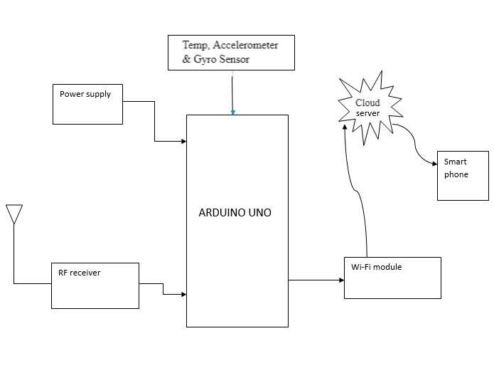
Architecture Diagram

Slide 23
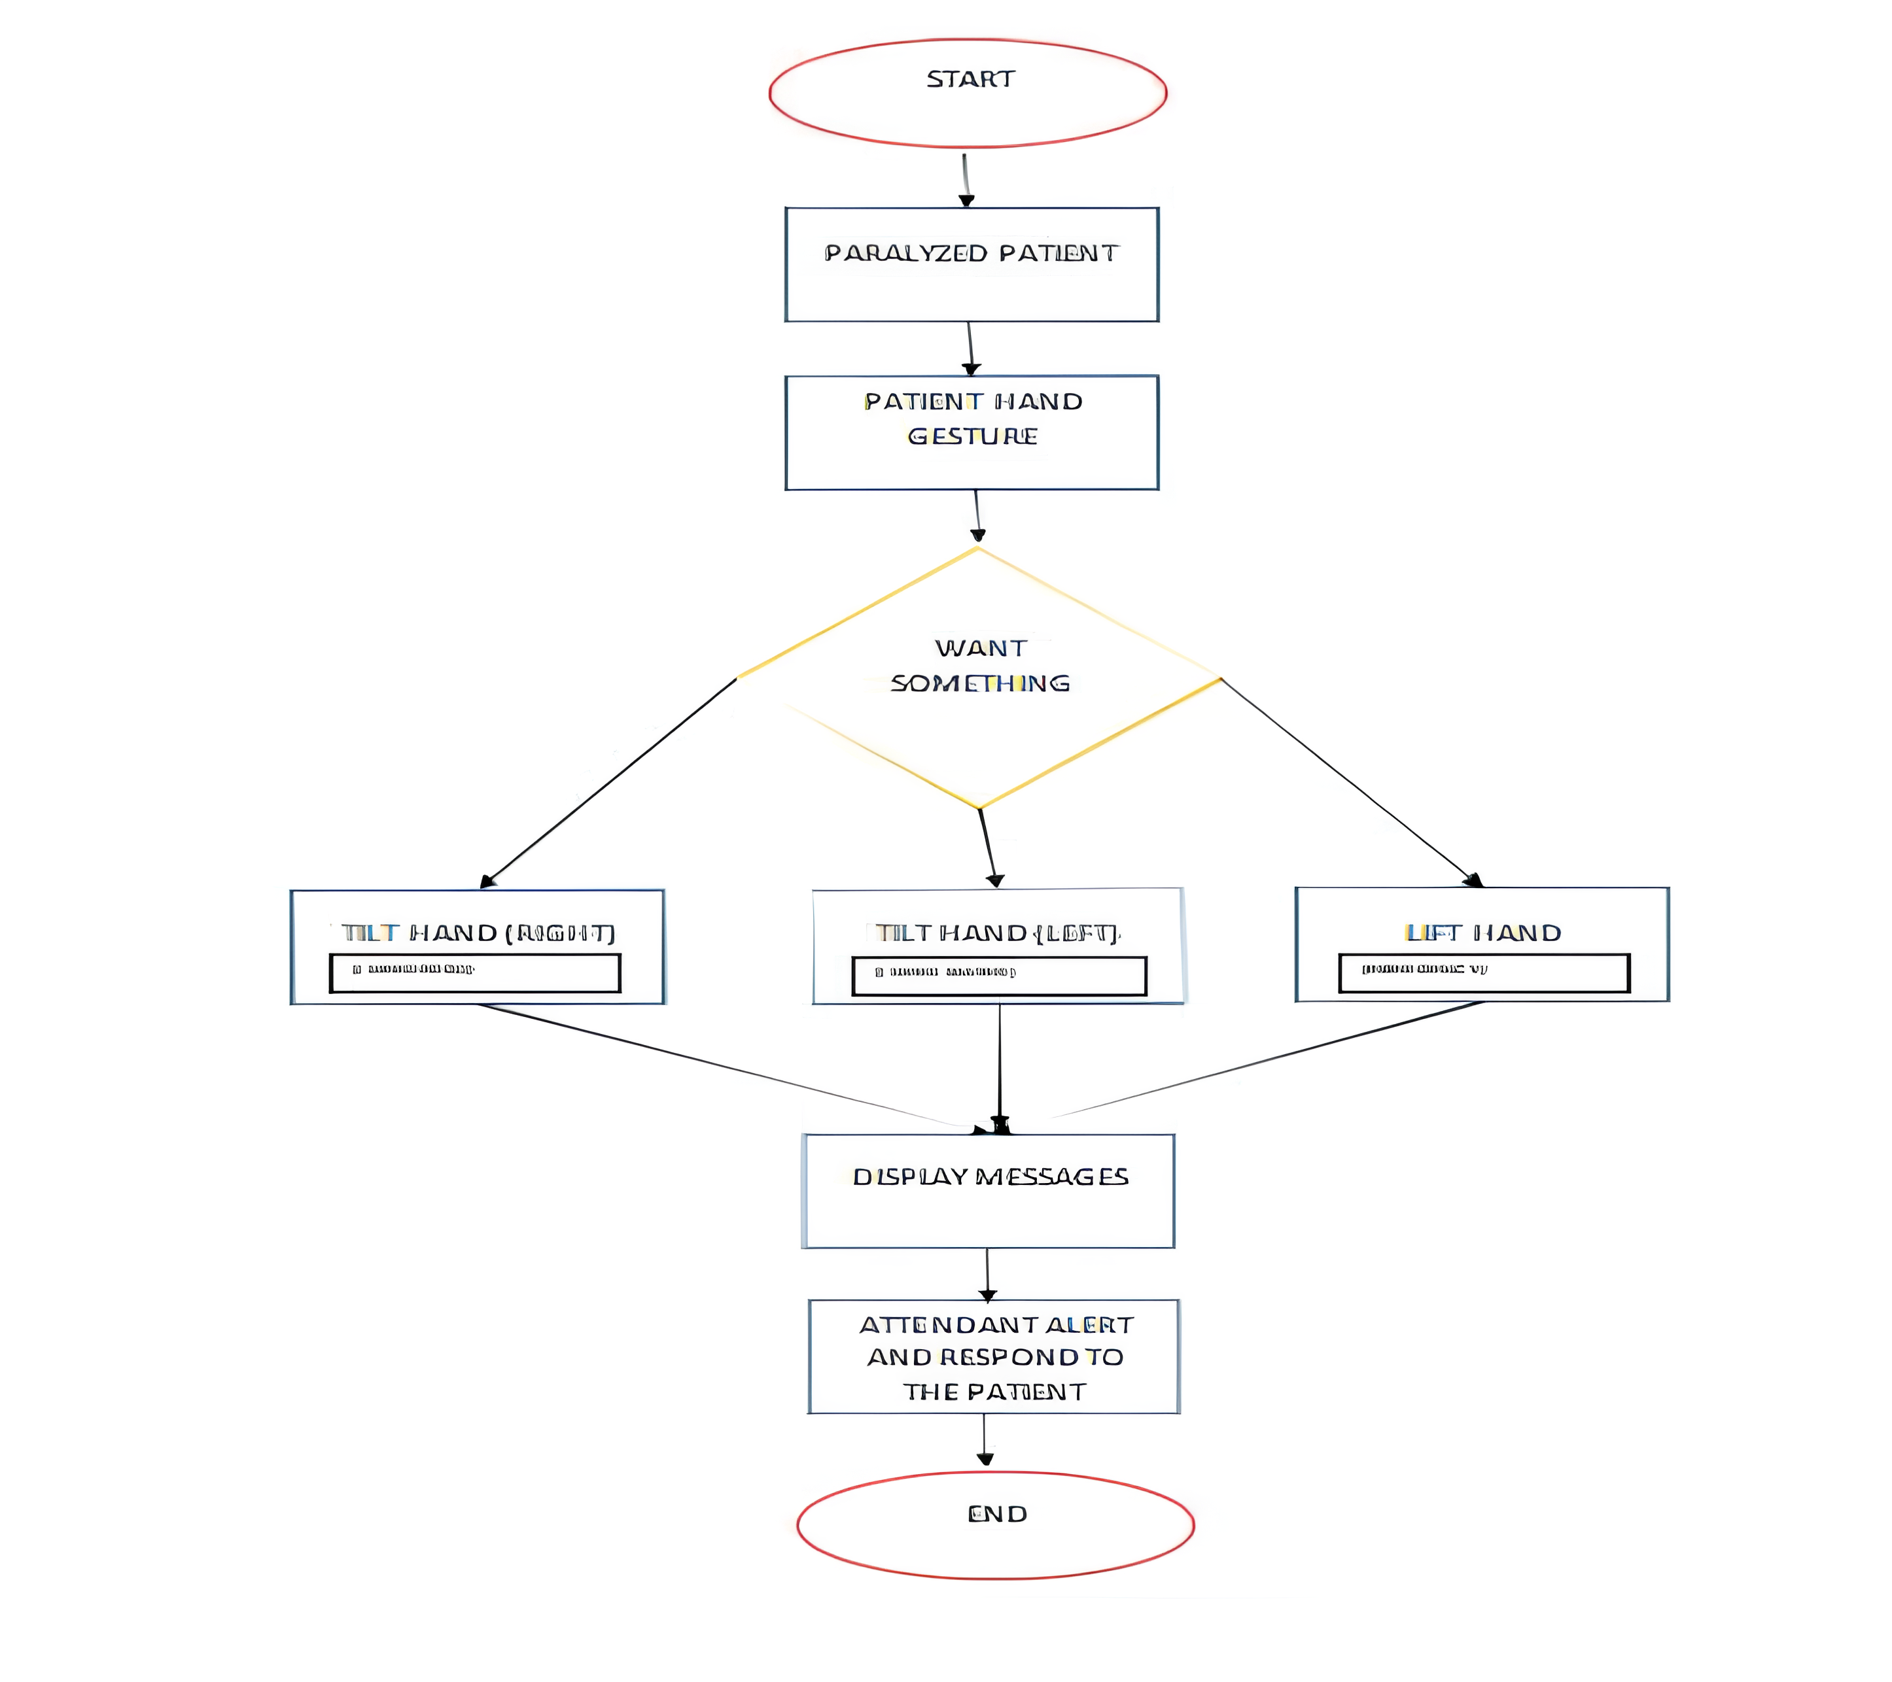
Flow Diagram

Slide 24
Modules
Input – This stage involves Arduino, sensors(hc-sr04) which captures the data. The data collection can be done using microprocessor(NodeMCU) which can be sent for processing capablilities.
Processing – After data collection, the data needs to be sent to the cloud(using Wifi-Module) over the MQTT protocol using publish and subscribe messaging transport. The message is sent to the output after data processing is done.
Output – The actions which are need to be performed after data processing is to be displayed on the output device via. Mobile application.

Slide 25
Conclusion
In conclusion, Paramov: IoT-enabled healthcare for paralysis patients makes it possible to know the patients' requirements and health state even when they are in a faraway location.
This system paradigm is essential since it serving as a helping tool for those who suffer from paralysis. .
The communications are stored in the IoT cloud, which provides a long-term picture of the patient's health.
Paramov has the potential to transform healthcare delivery by offering personalized, realtime care and monitoring to individuals with paralysis

Slide 26
REFERENCES
[1] Pandey, M., Chaudhari, K., Kumar, R., Shinde, A., Totla, D., & Mali, N. D. (2018, August). Assistance for paralyzed patient using eye motion detection. In 2018 Fourth International Conference on Computing Communication Control and Automation (ICCUBEA) (pp. 1-5). IEEE.
[2] Kumar, M. V., Pandurangan, K., & Vinu, R. (2021, November). Automated paralysis patient monitoring system. In 2021 IEEE National Biomedical Engineering Conference (NBEC) (pp. 71-76). IEEE.
[3] Fan, Xiao, Wanrong Sun, Aifeng Ren, Dou Fan, Nan Zhao, Daniyal Haider, Xiaodong Yang, and Qammer H. Abbasi. "Detection and diagnosis of paralysis agitans." IEEE Access 6 (2018): 73023-73029.
[4] Varghese, N., Hepsiba, D., & Anand, L. V. (2022, April). Health Monitoring and Observatory System for Paralysed Patients using Blynk Application. In 2022 6th International Conference on Devices, Circuits and Systems (ICDCS) (pp. 322-326). IEEE.
[5] Priya, A. D., & Sundar, S. (2019, March). Health monitoring system using IoT. In 2019 International Conference on Vision Towards Emerging Trends in Communication and Networking (ViTECoN) (pp. 1-3). IEEE.

Slide 27
REFERENCES
[6] Zeb, K., Mahmood, A., Uddin, W., Khan, M. A., & Kim, H. J. (2019, January). Healthcare monitoring system and transforming monitored data into real time clinical feedback based on IoT using Raspberry Pi. In 2019 2nd International Conference on Computing, Mathematics and Engineering Technologies (iCoMET) (pp. 1-6). IEEE.
[7] Shaikh, S., & Chitre, V. (2017, May). Healthcare monitoring system using IoT. In 2017 International Conference on Trends in Electronics and Informatics (ICEI) (pp. 374-377). IEEE.
[8] Annepu, Visalakshi, Adnan Naji Jameel AL-Tamimi, H. S. S. Aljibori, Naga Raju Challa, Kalapraveen Bagadi, M. N. Mohammed, Oday I. Abdullah, M. Alfiras, and Rabab Alayham Abbas Helmi. "Implementation of an Efficient IoT Enabled Automated Paralysis Healthcare System." In 2023 IEEE 8th International Conference on Engineering Technologies and Applied Sciences (ICETAS), pp. 1-6. IEEE, 2023.
[9] Usha, S., Jeevitha, G., Logesh, M., Karthik, M., Kaviyaa, M., & Prasanth, S. S. (2023, September). IoT based Integrated Health Care Monitoring System. In 2023 4th International Conference on Smart Electronics and Communication (ICOSEC) (pp. 353-358). IEEE.

Slide 28
REFERENCES
[10] Akash, M. R. R., & Shikder, K. (2020, February). IoT based real time health monitoring system. In 2020 Research, Innovation, Knowledge Management and Technology Application for Business Sustainability (INBUSH) (pp. 167-171). IEEE.
[11] Akram, P. Saleem, M. Ramesha, Sai Aamani Sindhu Valiveti, Shaik Sohail, and K. Teja Samba Siva Rao. "IoT based remote patient health monitoring system." In 2021 7th International Conference on Advanced Computing and Communication Systems (ICACCS), vol. 1, pp. 1519-1524. IEEE, 2021.
[12] Siam, Ali I., Mohammed A. El-Affendi, Atef Abou Elazm, Ghada M. El-Banby, Nirmeen A. El-Bahnasawy, Fathi E. Abd El-Samie, and Ahmed A. Abd El-Latif. "Portable and real-time IoT-based healthcare monitoring system for daily medical applications." IEEE Transactions on Computational Social Systems (2022).
[13] Khan, T., & Chattopadhyay, M. K. (2017, August). Smart health monitoring system. In 2017 International Conference on Information, Communication, Instrumentation and Control (ICICIC) (pp. 1-6). IEEE.

Slide 29
REFERENCES
[14] Kishore, A. S., Chinni, G. R., JayaLakshmi, G., & Reddy, K. S. K. (2023, February). Smart Healthcare Monitoring System Using IoT Technology. In 2023 11th International Conference on Internet of Everything, Microwave Engineering, Communication and Networks (IEMECON) (pp. 1-5). IEEE.
[15] Pirani, Z., Momin, A., Kadri, A., & Shaikh, A. (2018, June). Survey of Numerous Accessible Applications for Paralysis Patients. In 2018 Second International Conference on Intelligent Computing and Control Systems (ICICCS) (pp. 1965-1969). IEEE.

Slide 30
Thank You

